Slide 1
General CUDA Tips
CS179 2021 – Ethan Jaszewski

Slide 2
Nvidia Libraries
cuBLAS
Generalized BLAS package that runs on GPU
Highly performance tuned (never write your own BLAS kernels)
cuSPARSE
Performant sparse matrix multiplication library
Supports fully sparse and mixed (i.e., sparse and dense) operations
cuSOLVER
Performant solvers for dense and sparse matrices
cuRAND
Performant GPU-oriented random number generation
Callable both in-kernel and via host code
cuFFT
Performant GPU FFT with FFTW-style interface
Supports multi-gpu and asynchronous computation
cuDNN
GPU-accelerated library of ML primitives
Highly performance tuned

Slide 3
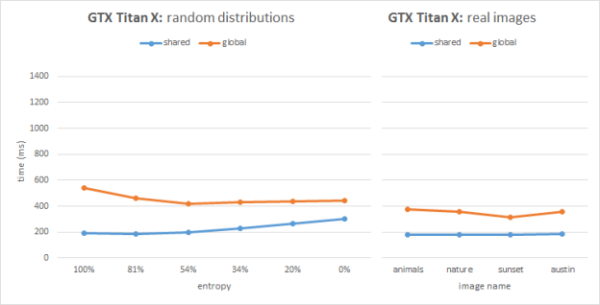
Useful Operations
Warp Shuffle
Fast way to exchange data within a warp
Helps avoid __syncthreads() calls
Helps simplify code significantly
Shared Memory Atomics
Normal atomic operations – just to shared memory
Much faster than global memory atomics
Available on Maxwell and later GPUs

Slide 4
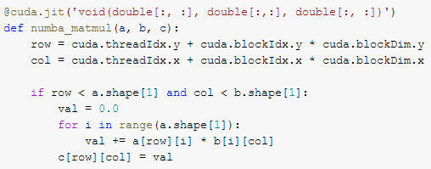
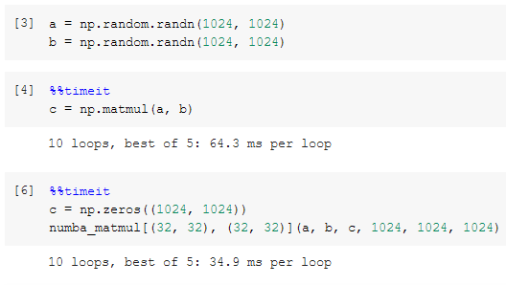
Numba
Essentially just CUDA in Python
Easy interop with Numpy
Can be used through Jupyter (i.e., Google Colab)
Provides bindings to Nvidia APIs through pyculib
pyculib provides:
cuBLAS
cuSPARSE
cuRAND
cuFFT

Slide 5
Misc. Tips
Pay attention to block and grid dimensions
Well-dimensioned kernels can be a lot faster
Different kernels might need different block shapes
Avoid atomic operations when possible
Atomic operations and __syncthreads() are slow!
Pay attention to memory
Most kernels are memory bandwidth limited
Try to do a “good amount” of work for the input data
Use the Nvidia APIs
They are highly optimized for most operations
Avoid premature optimization
Start simple, then improve iteratively
Don’t optimize things that don’t matter
Enable –O3 on your compiler!

Slide 6
Questions?

